Slide 1
Blood Sugar Monitoring using Pervasive Computing Technologies
R.Vijayarajan
K.Shenbagaram
J.Praveen Kumar
Guided by
Dr.T.Revathi
HOD IT Department

Slide 2
Aim
To remotely monitor the blood sugar level of a diabetic patient using a Glucometer and RF transceiver

Slide 3
Objective
To facilitate the monitoring of diabetic patients remotely using pervasive computing technology

Slide 4
Hardware Requirements
Glucometer
RF module operating at 433MHz
MSP430 microcontroller for translating the readings from glucometer into compatible format for sending using the RF transmitter

Slide 5
Software Requirements
Keil uvision – An assembly language editor for programming the microcontroller
Java – To design the GUI and to facilitate sending of E-mail

Slide 6
Modules
Interfacing glucometer with the microcontroller and transferring data from glucometer to the RF transmitter in a compatible format
Reading the data from the RF receiver and converting it back to usable format in PC
E-Mailing the glucometer reading along with the date to the doctor’s e-mail ID

Slide 7
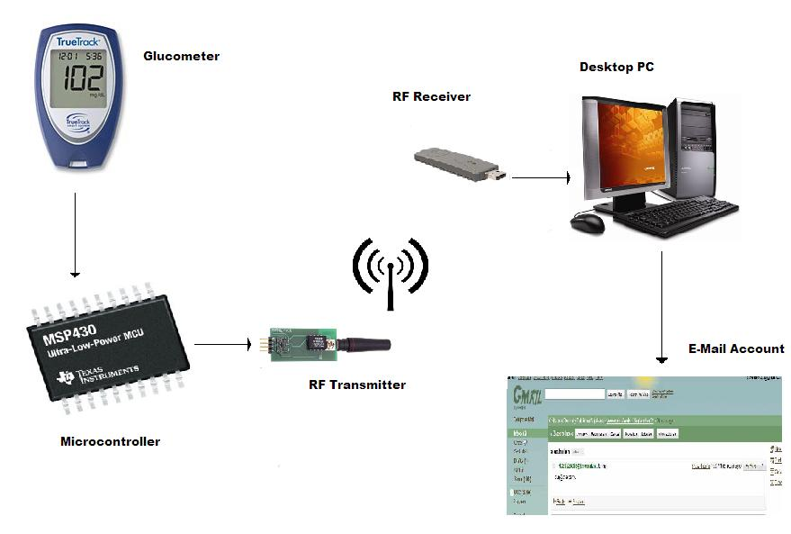
Block Diagram

Slide 8
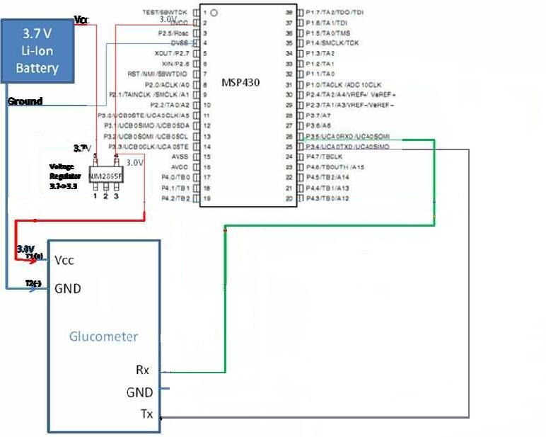
Pin Diagram

Slide 9
Thank You!!

